Slide 1
Travel Insurance Case Study
By Hesham Ibrahim

Slide 2
Business Goals
Covid-19 has greatly impacted the Travel industry.
Most companies decided to cut budge.
More efficient marketing is needed
the marketing team needs to better understand the different traveler’s profiles to create better targeted plans

Slide 3
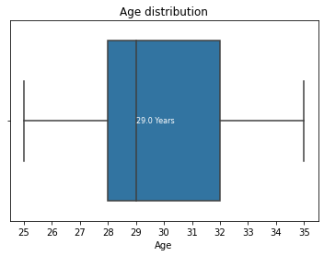
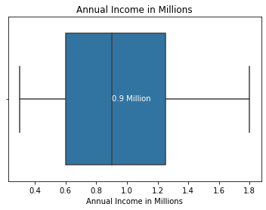
Data Validation
Our data has no outliers when it comes to age and annual income, resulting into more accurate insights.

Slide 4
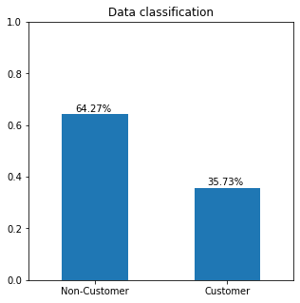
Data Validation
The data is nicely divided between customers and non-customer.
The business is preforming better than the Pareto principle (80-20 rule)

Slide 5
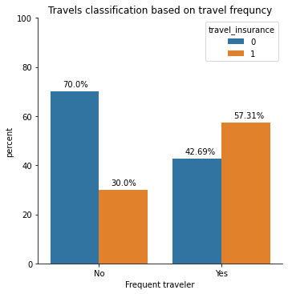
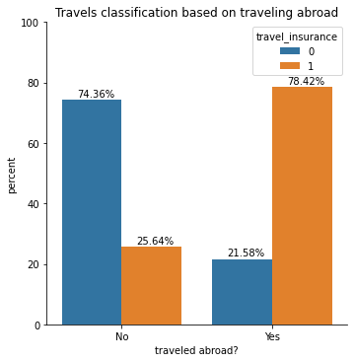
Outcome:
Are there differences in the travel habits between customers and non-customers?
Frequent travelers are more luckily to buy insurance than non frequent ones
People who has travelled abroad tends to buy insurance when travelling.

Slide 6
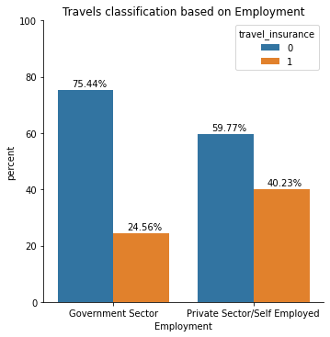
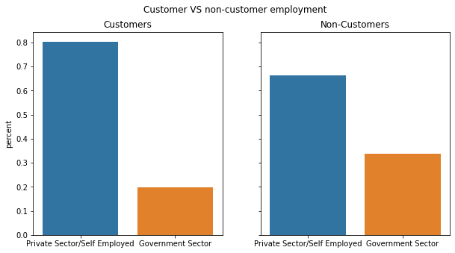
Outcome:
What is the typical profile of customers and non-customers?
The majority of the customers are either working for a private company or self employed. However almost 25% of public employees purchased insurance.

Slide 7
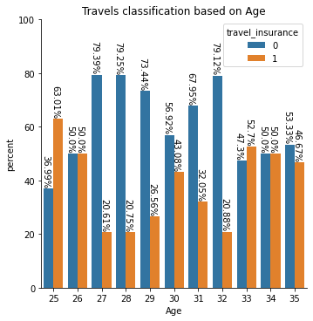
Outcome:
What is the typical profile of customers and non-customers?
Age has impact on insurance purchasing

Slide 8
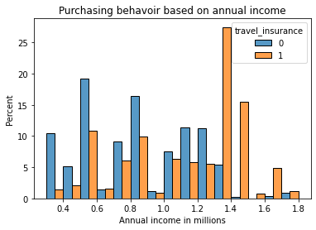
Outcome:
What is the typical profile of customers and non-customers?
High annual income travelers ( more than $1.35M) would insure.

Slide 9
Outcome:
What is the typical profile of customers and non-customers?
The data shows that the typical profile of a customer is most luckily someone who has either travelled aboard or a frequent flyer.
Travelers with annual income more than $1.35M are going to get insurance.
Travelers younger than 27 or older than 32 tend to buy insurance, however the age group of 27 to 32 tend to not

Slide 10
Recommendation:
The marketing team should focus on:
Frequent travelers and those who have already travelled abroad.
The private sector and self employed should get at least 75% of the marketing budget, however about 25% should be used to target public employees.
Travelers in age group of 23 to 26 and 28 to 33.
There must be special plan for travelers with higher annual income.

